Slide 1
RuleManager – add rule
{Rule} := if {conditions} then {actions}
[RuleSet]
Conditions
Rule
mode
Rule
state
Rule
Rule
Rule
Rule
Actions

Slide 2
RuleManager – add rule
{Rule} := if {conditions} then {actions}
[RuleSet]
Conditions
Rule
mode
Rule
state
Rule
Rule
Rule
Rule
Actions
Condition
Action
NoAction
Condition
Action
NoAction
Conflict

Slide 3
RuleManager – add rule
{Rule} := if {conditions} then {actions}
[RuleSet]
Conditions
Rule
mode
Rule
state
Rule
Rule
Rule
Rule
Actions
Condition
Action
NoAction
Condition
Action
NoAction

Slide 4
RuleManager – add rule
{Rule} := if {conditions} then {actions}
[RuleSet]
Conditions
Rule
mode
Rule
state
Rule
Rule
Rule
Rule
Actions

Slide 5
RuleManager – monitor sensor
{Rule} := if {conditions} then {actions}
[RuleSet]
Conditions
mode
Rule
state
Rule
Rule
Rule
Rule
Match!
Condition
Action
NoAction
Condition
Action
NoAction

Slide 6
RuleManager – do action
{Rule} := if {conditions} then {actions}
[RuleSet]
denied
mode
Rule
state
Rule
Rule
Rule
Rule
Actions
Match!
Condition
Action
NoAction
Condition
Action
NoAction

Slide 7
RuleManager
{Rule} := if {conditions} then {actions}
[RuleSet]
Conditions
Rule
mode
Rule
state
Rule
Rule
Rule
Rule
Actions
Rule
Condition
Action
NoAction
Condition
Action
NoAction

Slide 8
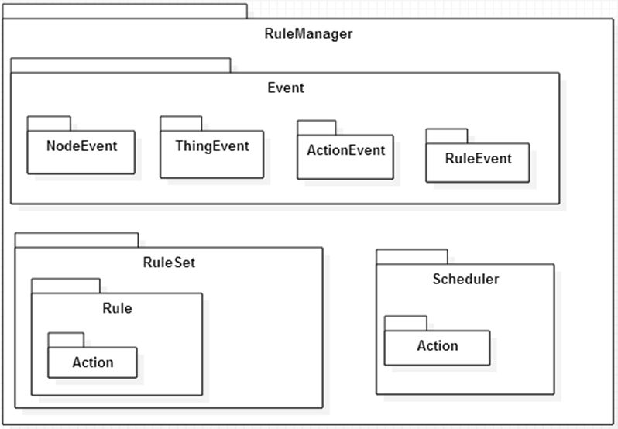
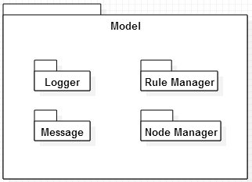
Static Perspective
: Package
(Class or Set of
Classes)

Slide 9
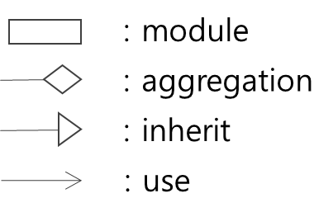
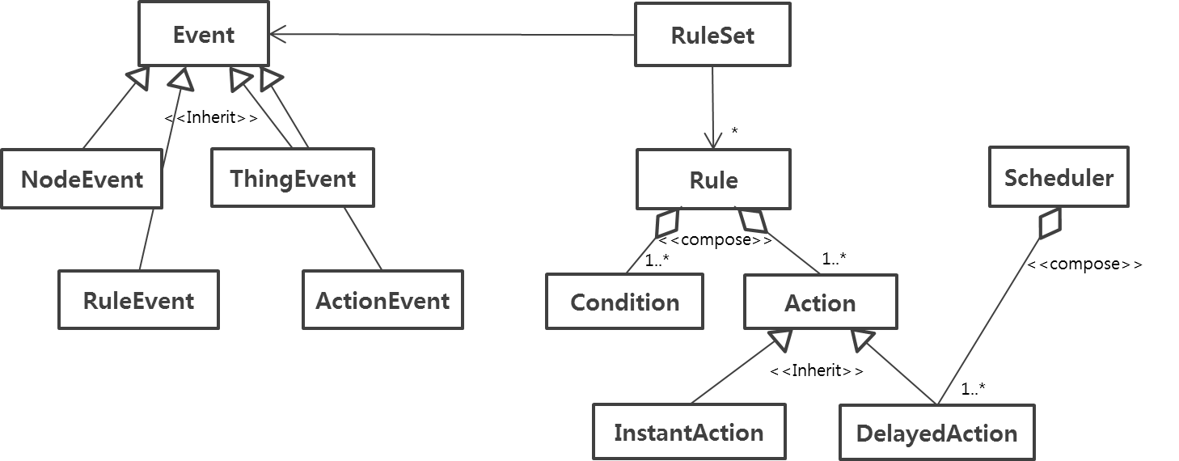
RuleManager
EventControl
<<Use>>
<<Has>>
StateEvent
ConfigEvent
RuleManager Storage
RuleManager DBStorage
RuleManager FileStorage

Slide 10
register timed action
expire
scheduler
RuleManager
DB
save config
Config
Delay action
load config
save rules
load rules
Rule
RuleSet
use
execute
Instant Action
Condition
ConfigEvent
E v e n t B u s
Update config
check permission
get
matched actions
Add/remove
rule
Change mode (alarm/general)
ActionEvent
ThingEvent
RuleEvent
StateEvent
A
B
: JSON event , from A to B
1…*
DB
Object
RuleManager
Event Receiver
Singleton object
Push event
thread
process event
A
B
Event Queue
: information, from A to B
queue

